Slide 1
Generation of synthetic data from real MNO data through Neural Network: motivations, techniques and preliminary results
1st June 2022
5th web meeting of the Task Force on Mobile Network Operator data for official statistics (TF MNO)
NOME COGNOME
Istat | Direzione

Slide 2
OUTLINE
Why use synthetic data
How to generate synthetic data

Slide 3
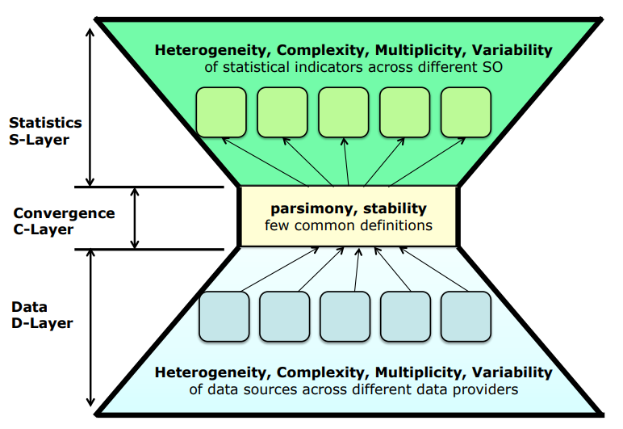

Why use synthetic data
RMF- Reference Methodological Framework for MNO
Statistical Population
A PROXY
Of Statistical Popolation obtained by source data
ESTIMATES
Statistics Layer
constraints, definitions, rules, algorithms, data transformation
Data Layer
data source
3
Notes:
we think it is useful to re-propose, very quickly, some slides from the last presentation, to explain why we thought synthetic data are useful.
In particular at what point in the process do we find this data useful.
In the Reference Methodological Framework for MNO represented by the hourglass shape where we distinguish three different layers: Data Layer, Convergence Layer and Statistics Layer.
In these three levels the raw data are transformed according to specific definitions and algorithms to provide the sufficient information to generate the statistical data (here we named A PROXY Of Statistical Popolation ) these Data will feed: indicators and estimates on the populations of interest.
the processing and transformation algorithms of the raw data are concentrated in the convergence level to build the aggregate data that the MNOs provide to NSI for their statistics.

Slide 4
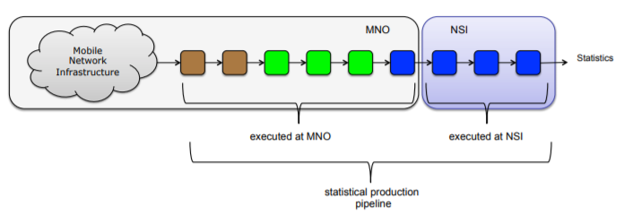

Why use synthetic data
Can synthetic data transform the pipeline in a new way?
Algoritms to define:
Localization;
Statistical concept (e.i: usually resident population )
or parameters (e.i.: what is the timing of night?)
Synthetic
DATA
Open-source by Sinthetic data
reference pseudo-code description
open-source
human-readable guidelines
Notes:
If you remenber The steps of the pipelene are green, blu or brown coloured according to the transparency of the algorithms used to make it.
In particular, the green activities performed on the raw data can be shared with a speudo code, but perhaps even more, developed in collaboration MNO-NSI.
In such a way that the code developed by NSI thanks to synthetic data can then be applied to real data.
In this case the ownership of the algorithms would be of the NSI and could be shared.
The Night Population is population usually staying in a place during the night for a period

Slide 5

How to use synthetic data
MNO
NSI
Execute synthetic data generation algorithms
Define algoritm to tranform MNO data
Code of Algorithms
read
read
MND
Write/send
Synthetic data
Execute Code

Slide 6
How to generate synthetic data
Statistical models, such as Bayesian networks, or Hidden Markov models, provide an explicit, parametric model of real data distribution. The features these models extract from their training data is determined upfront.
Non-parametric models, such as generative adversarial networks (GANs) or variational auto encoders (VAEs), do not estimate a parametric likelihood function to generate new samples from a representation of the joint multivariate distribution of real data.
We focused on:
the development of CTGAN
and the evaluation of Utility metrics and Privacy metrics
Always keeping in mind use and nature of these senthetic data which:
must represent the characteristics of real data (SIM code, antenna/sector code and Time)
do not need to be necessarily extended in space and time as they will be used to develop algorithms in house of NSI

Slide 7
The experimentation (1/2)
Dataset
A random sample of WIND's CDR
Dimension: 10,000 rows – 4 attributes
Attributes: NUM_CALLER_KEY (Sim code)
CALL_DATE
TIME_MIN_CALL (Time call)
CELL_CALL_CODE (Antenna code)
Pre-proceesing (steps)
Pseudo-anonymization
Setting of data-type: categorical (SIM code, Antenna codes) or continuous(date and time of calls)

Slide 8
The experimentation (2/2)
Process
Input : a random sample of WIND's CDR (original dataset)
Type of process: generate synthetic data
Framework used: SDGym - Synthetic Data Gym Metrics Evaluation ( https://github.com/sdv-dev/SDGym )
Algorithm used to generate synthetic data: Synthetic Data Vault (SDV) – based on CTGAN
Output: synthetic dataset of WIND's CDR (synthetic dataset)
Original Data
Synthetic Data
SDGym - SDV - CTGAN

Slide 9
A first analysis
Graphical analysis of comparison of univariate and bivariate distributions on categorical values of real data and synthetic data
Inserire qui il grafico della distribuzione dei dati reali
Inserire qui il grafico della distribuzione dei dati sintetici

Slide 10
Model Evaluation via SDGym Tools: Statistical Metrics
MI E’ ANDATO IN ERRORE IL CODICE

Slide 11
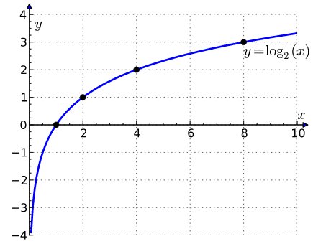
Model Evaluation via SDGym Tools: Likelihood Metrics
The metrics of this family compare the tables by fitting the real data to a probabilistic model and afterwards compute the likelihood of the synthetic data belonging to the learned distribution.
Bayesian Networks Likelihood is the Error calculated on Synthetic data after fitting the model on Real Data. Very low error (likelihood) like 0.00013183 means the two datasets are very close in terms of probabilistic models.
With very low error (close to 0) according to the Log function, the output value must be negative such as: -17.415473543655498, so it is very good.

Slide 12
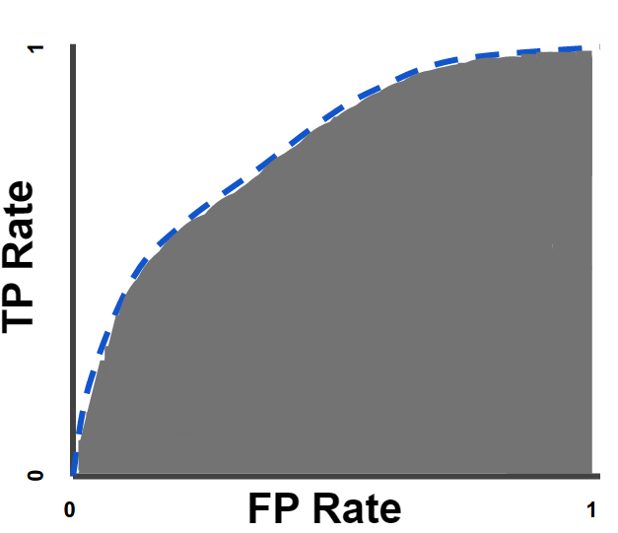
Model Evaluation via SDGym Tools: Detection Metrics
The metrics of this family evaluate how hard it is to distinguish the synthetic data from the real data by using a Machine Learning model. To do this, the metrics will shuffle the real data and synthetic data together with flags indicating whether the data is real or synthetic, and then cross validate a Machine Learning model that tries to predict this flag.
The output of the metrics will be the 1 minus the average ROC AUC score across all the cross validation splits. So the higher it is, the better it is.
an AUC of 1.0.
AUC stands for "Area under the ROC Curve." That is, AUC measures the entire two-dimensional area underneath the entire ROC curve (think integral calculus) from (0,0) to (1,1).
AUC provides an aggregate measure of performance across all possible classification thresholds. One way of interpreting AUC is as the probability that the model ranks a random positive example more highly than a random negative example. AUC represents the probability that a random positive (green) example is positioned to the right of a random negative (red) example. AUC ranges in value from 0 to 1. A model whose predictions are 100% wrong has an AUC of 0.0; one whose predictions are 100% correct has an AUC of 1.0.

Slide 13
Model Evaluation via SDGym Tools: Machine Learning Efficacy Metrics
This family of metrics will evaluate whether it is possible to replace the real data with synthetic data in order to solve a Machine Learning Problem by learning a Machine Learning model on the synthetic data and then evaluating the score which it obtains when evaluated on the real data.
The metrics on this family are organized by Machine Learning problem type and model (binary classification metrics, multiclass classification metrics, regression metrics)
In order to run these metrics we will need to select a column from our dataset which we will use as the target for the prediction problem.
Notice that the value returned by the metric does not only depend on how good our synthetic data is, but also on how hard the Machine Learning problem that we are trying to solve is.
Note: Since this metrics will be evaluated by trying to solve a Machine Learning problem, they can only be used on datasets that contain a target column that needs or can be predicted using the rest of the data, and the scores obtained by the metrics will be inversely proportional to how hard that Machine Problem is.

Slide 14
Model Evaluation via SDGym Tools: Privacy Metric
This family of metrics measures the privacy of a synthetic dataset by positing the question: given the synthetic data, can an attacker predict sensitive attributes in the real dataset? These models accomplish this by fitting an adversarial attacker model on the synthetic data to predict sensitive attributes from “key” attributes and then evaluating its accuracy on the real data.
In addition to the real and synthetic data, these metrics also require two additional inputs, sensitive_fields which is a list of columns considered private and key_fields which are the columns that will be used to try to predict the sensitive ones.
Notice that as all the involved columns are numerical, we need to apply a numerical privacy metric. Conversely, if all of the columns are categorical, we need to use a categorical privacy metric. Currently, the privacy metrics do not support mixed data types.
Note:These metrics do not accept missing data, so we will replace all the missing values with a 0 before executing them.
The output of this metric is between 0 and 1, where the closer the value is to 0, the less private it is.

Slide 15
grazie
NOME COGNOME | nome.cognome@istat.it

